Slide 1
BLASTNet 流体力学数据集
AI for science的重要数据集！
https://blastnet.github.io/

Slide 2
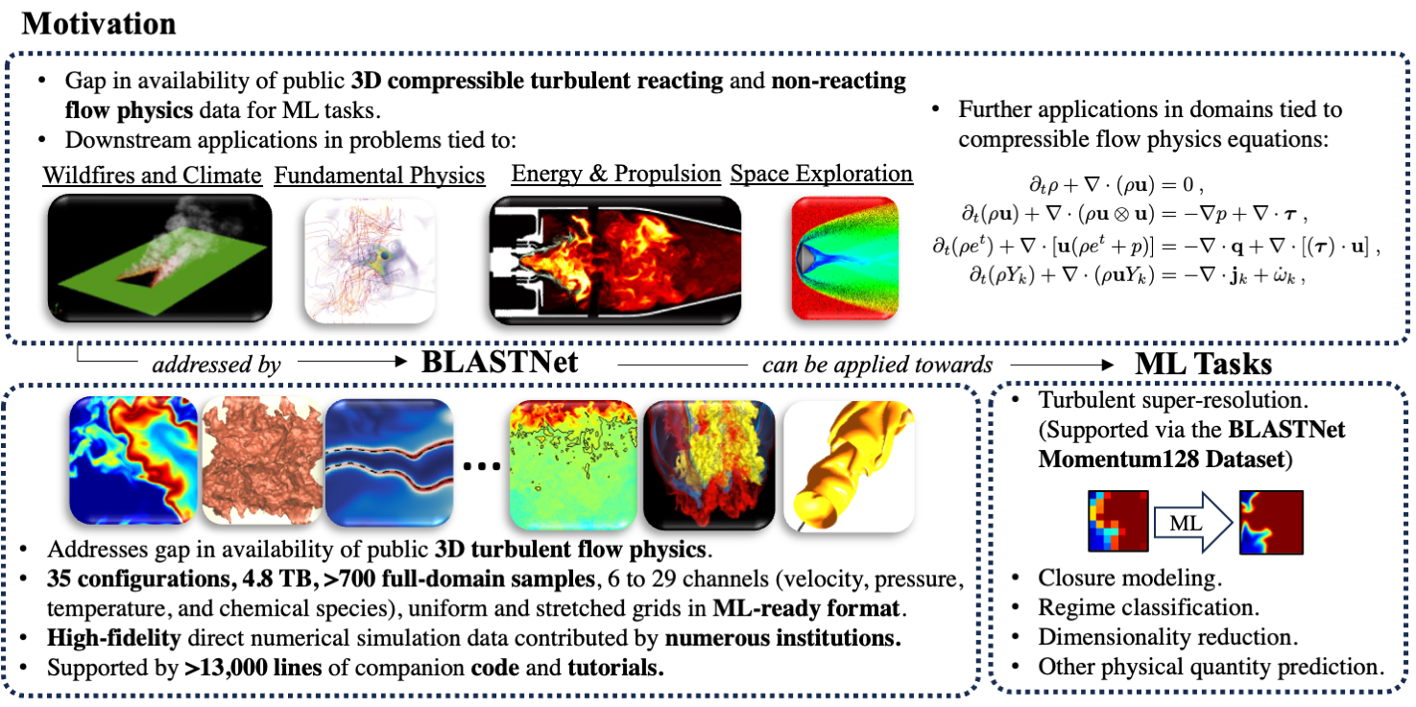
BLASTNet - Motivation

Slide 3
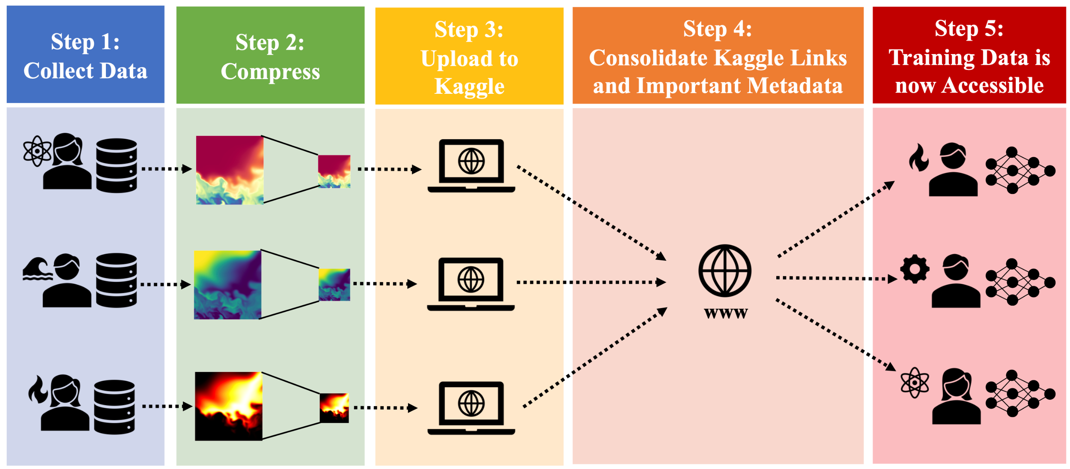
BLASTNet - Distribution

Slide 4
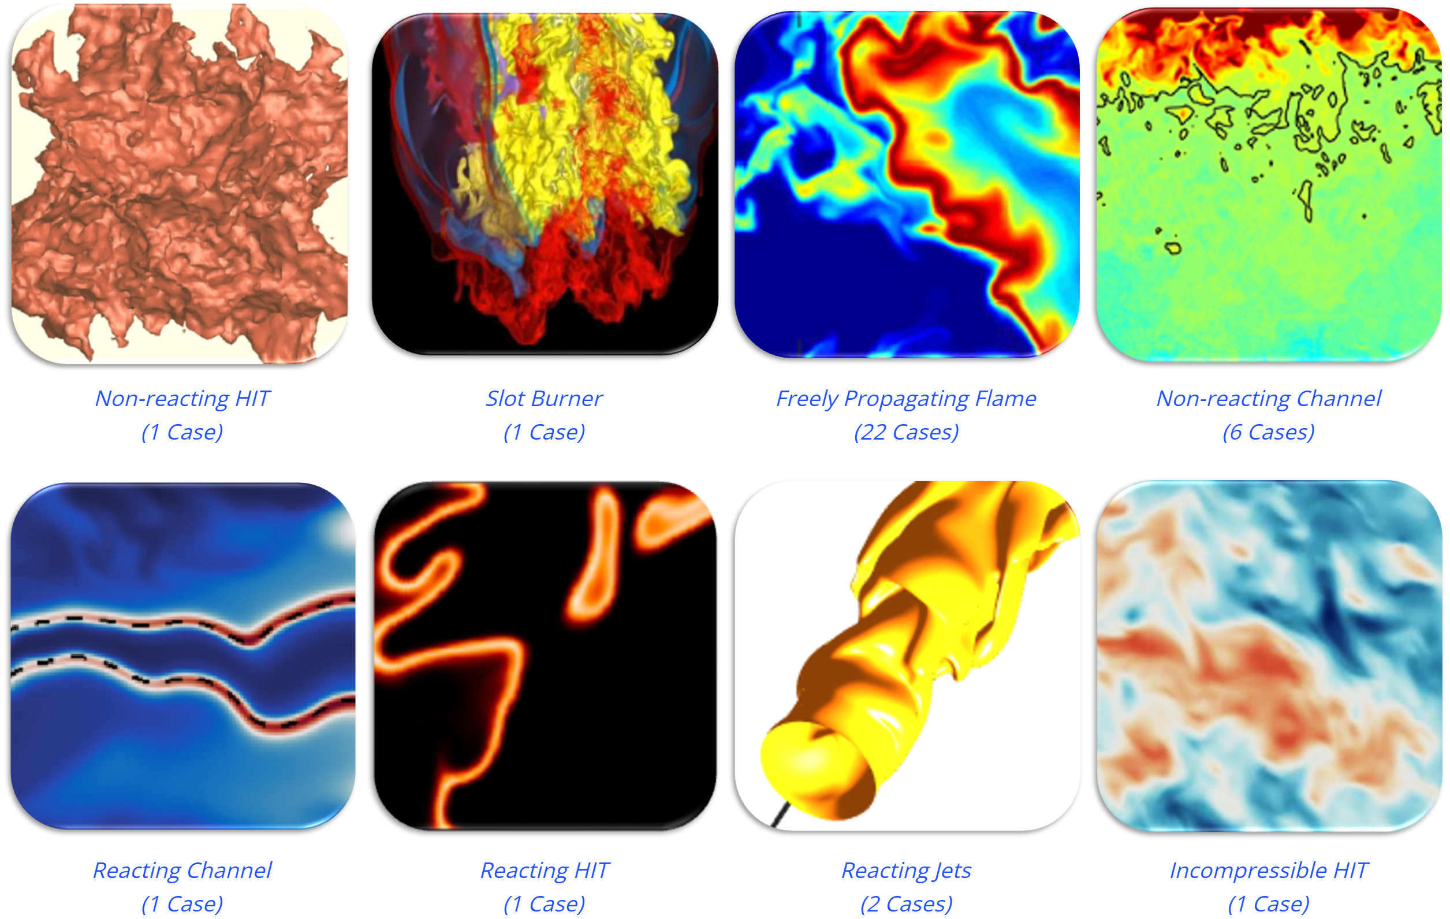
BLASTNet - Dataset Category
BLASTNet Simulation Dataset:

Slide 5
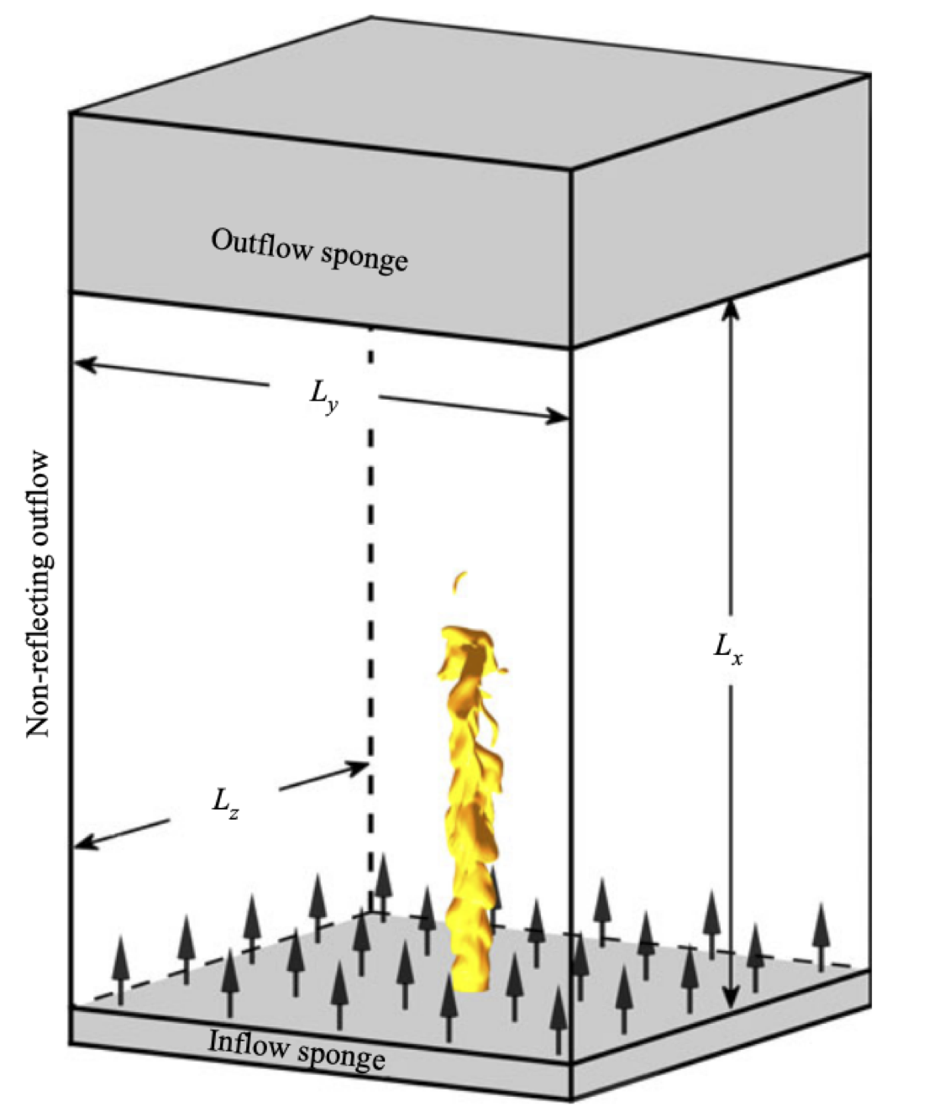
BLASTNet - Example of Simulated Dataset
Reacting Jet Flows ( https://blastnet.github.io/brouzet2021.html )
研究不同化学机制对火焰动力学的影响
执行代码 ：NTMIX-CHEMKIN
求解器：8th –order Explicit Centered Space Difference Scheme & 3rd –order Runge-Kutta

Slide 6
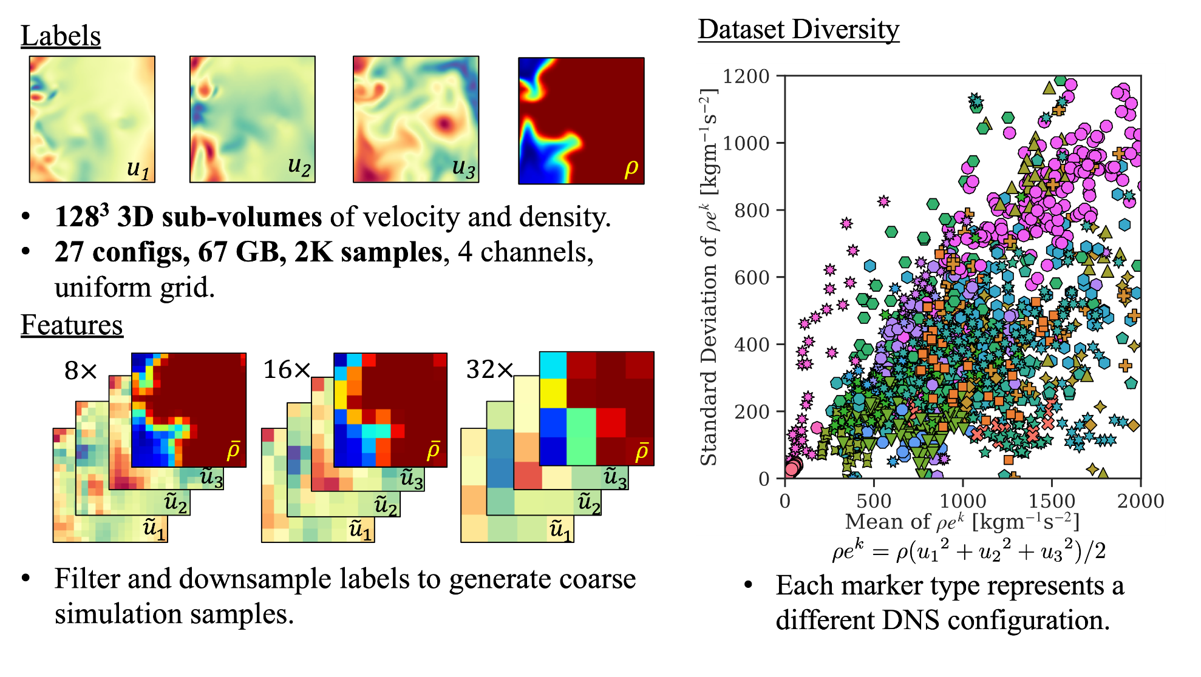
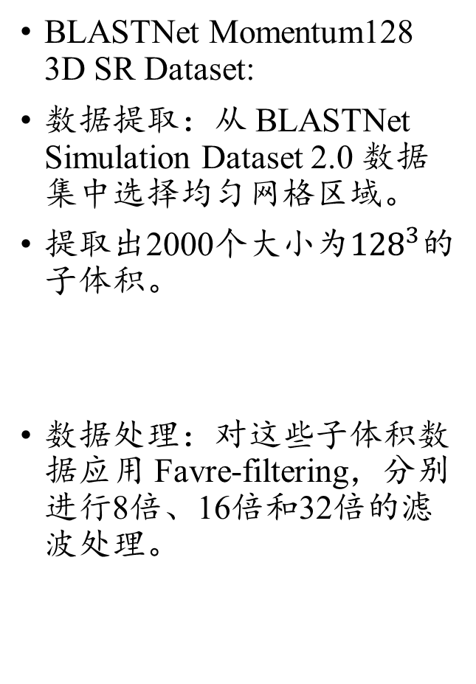
BLASTNet - Dataset Category
BLASTNet Momentum128 3D SR Dataset:
数据提取：从 BLASTNet Simulation Dataset 2.0 数据集中选择均匀网格区域。
提取出2000个大小为${128}^{3}$的子体积。
数据处理：对这些子体积数据应用 Favre-filtering，分别进行8倍、16倍和32倍的滤波处理。

Slide 7
CFD-Bench Generalization
许笑颜
xxy1101@mail.ustc.edu.cn

Slide 8
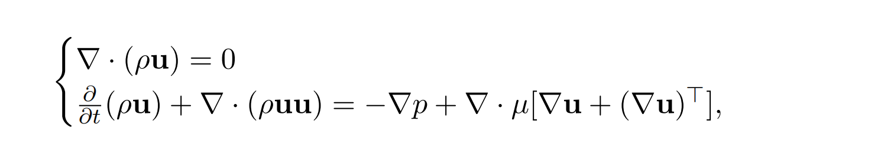
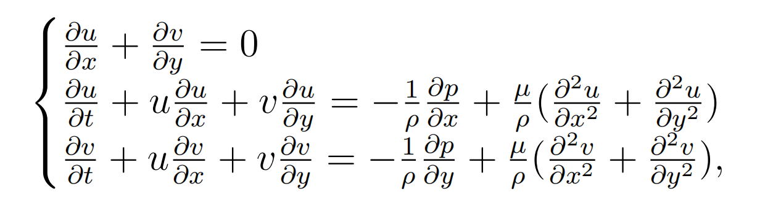
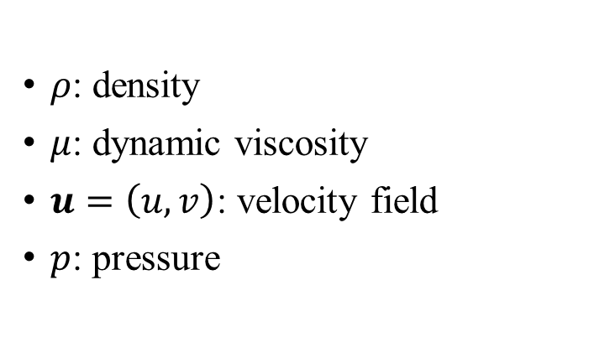
Definition of Flow Problems Dataset
$ρ$: density
$μ$: dynamic viscosity
$u=\left(u,v\right)$: velocity field
$p$: pressure
(1) cavity flow
(2) tube flow
(3) dam flow
(4) cylinder flow.

Slide 9
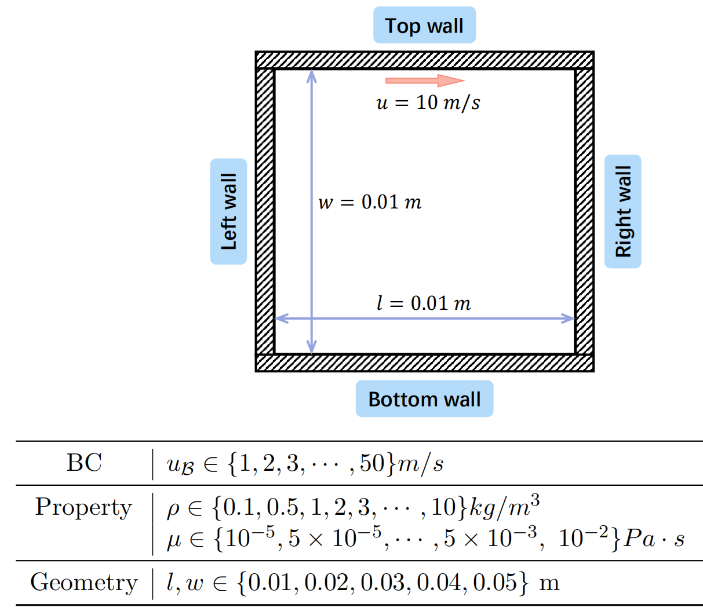
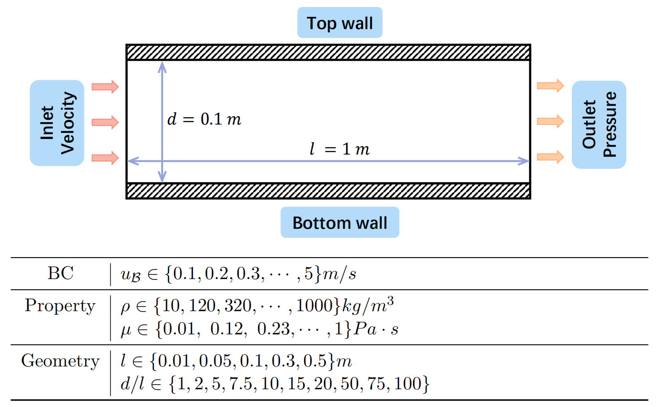
Cavity Flow & Tube Flow

Slide 10
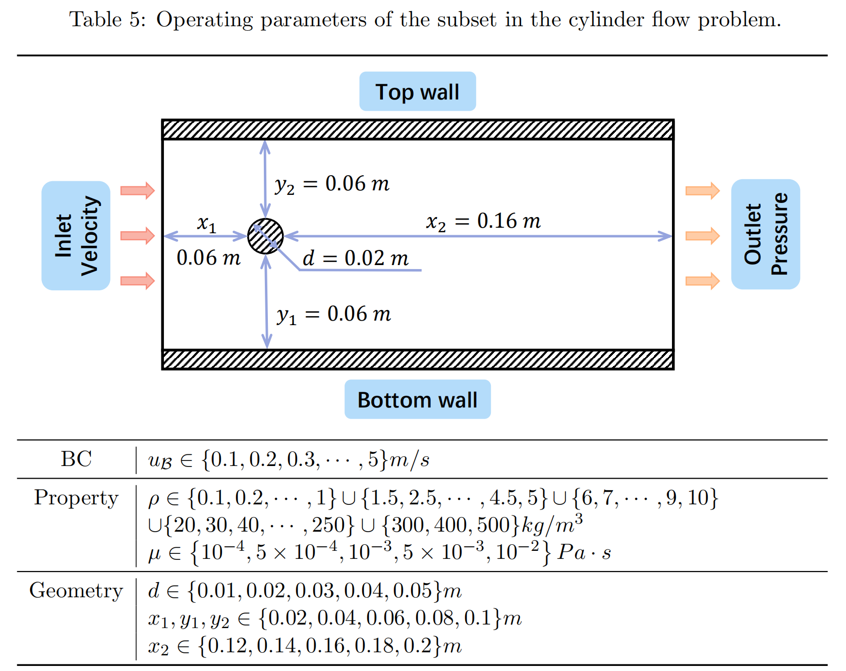
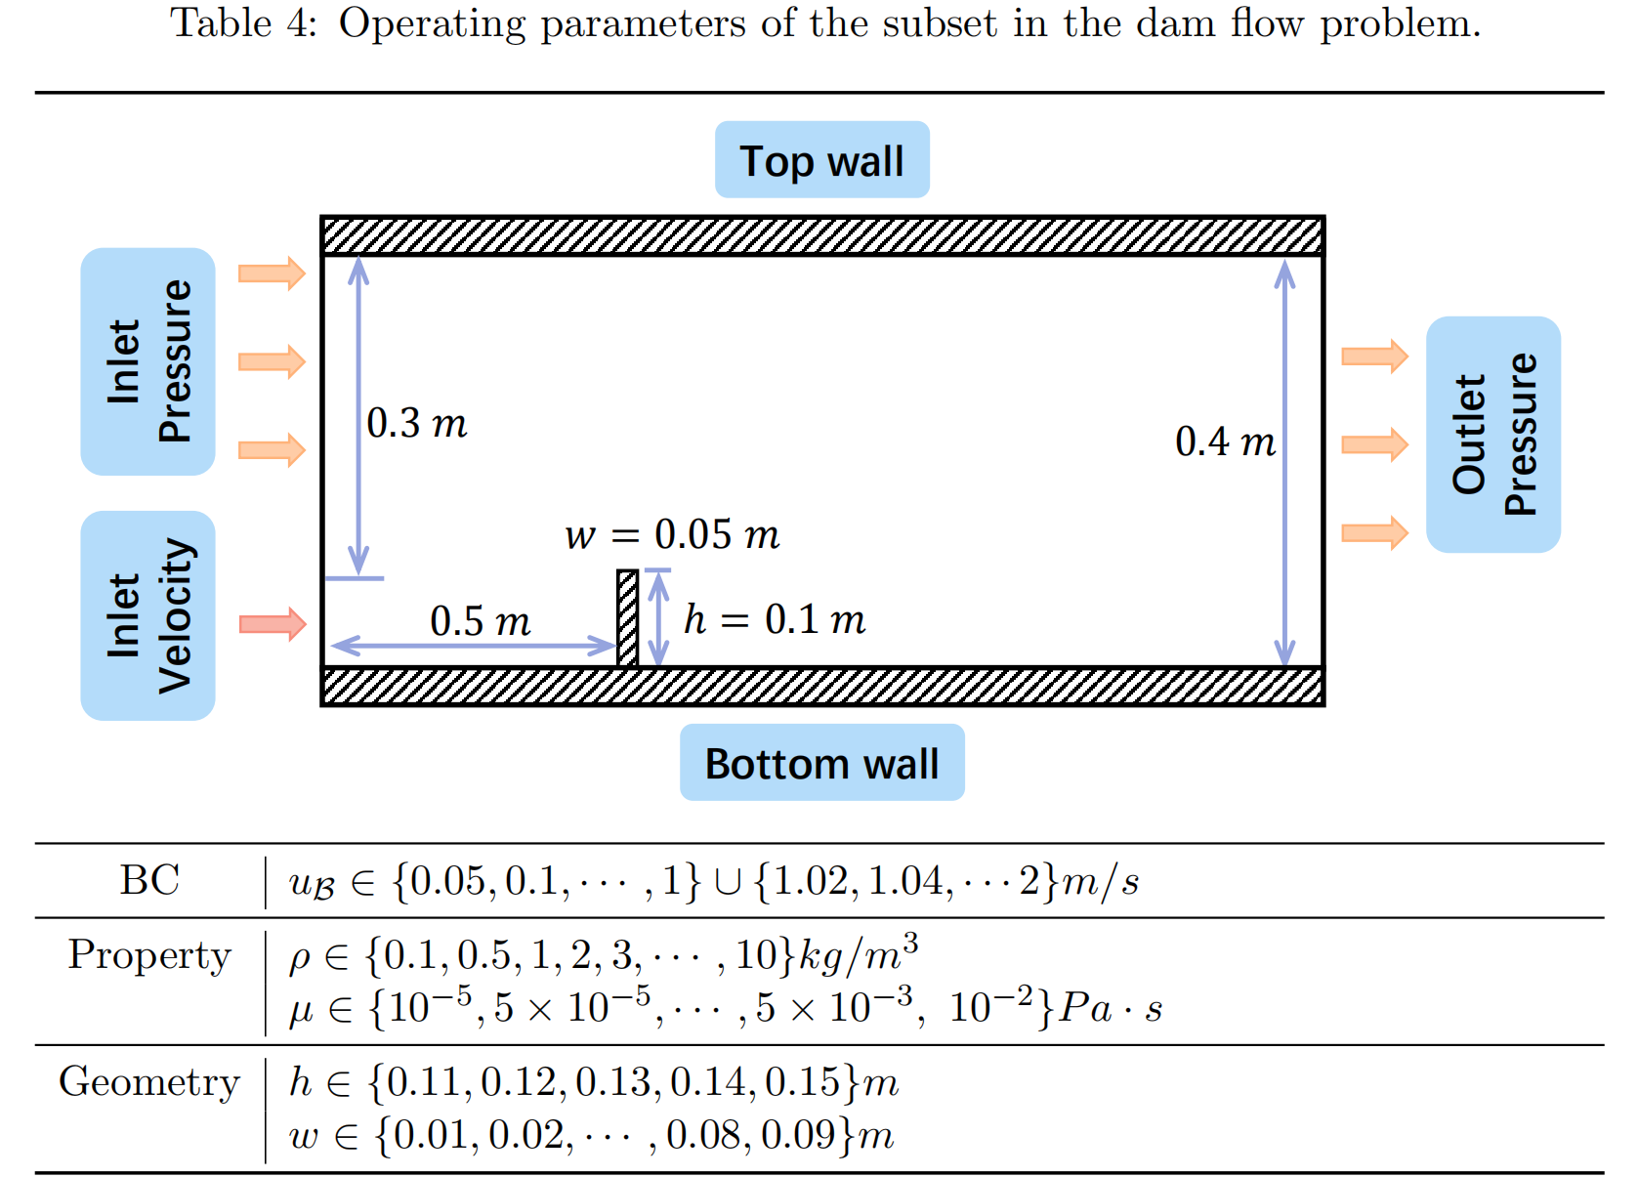
Dam Flow & Cylinder Flow

Slide 11
Data-driven discovery of partial differential equations
理解AI for science的重要文章！
许笑颜
xxy1101@mail.ustc.edu.cn

Slide 12
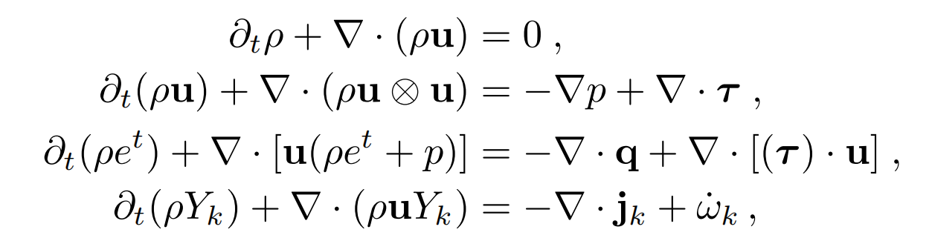
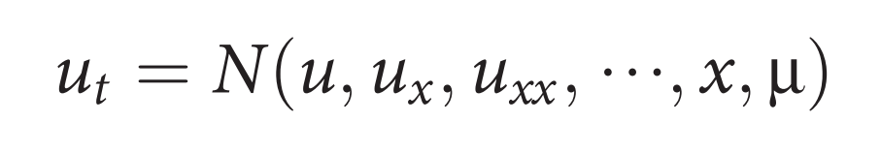
Research Background
How to discover the governing PDE(s) of a given system by time series measurements in the spatial domain?
How to gain the governing PDE?
The general form of governance equation?

Slide 13
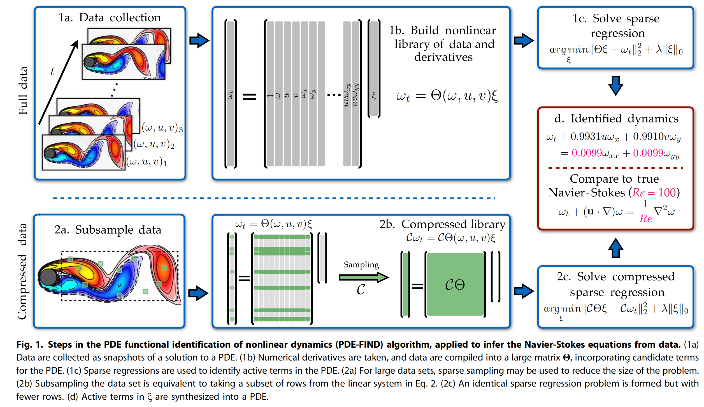
Pipeline

Slide 14
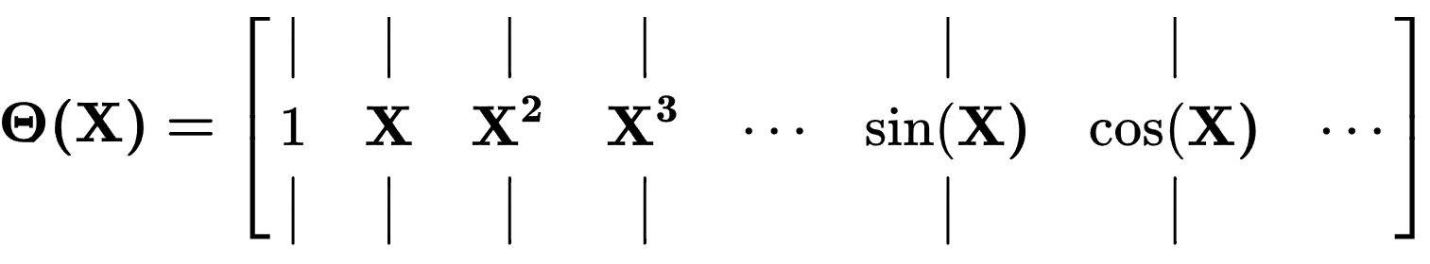
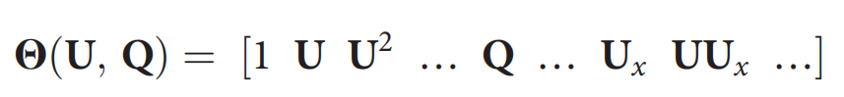
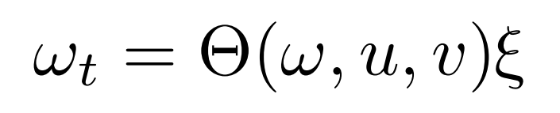
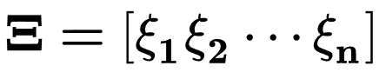

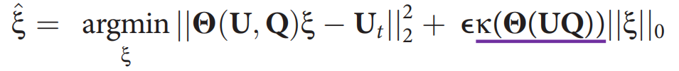
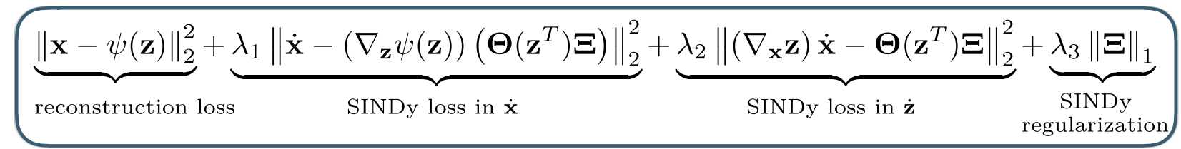
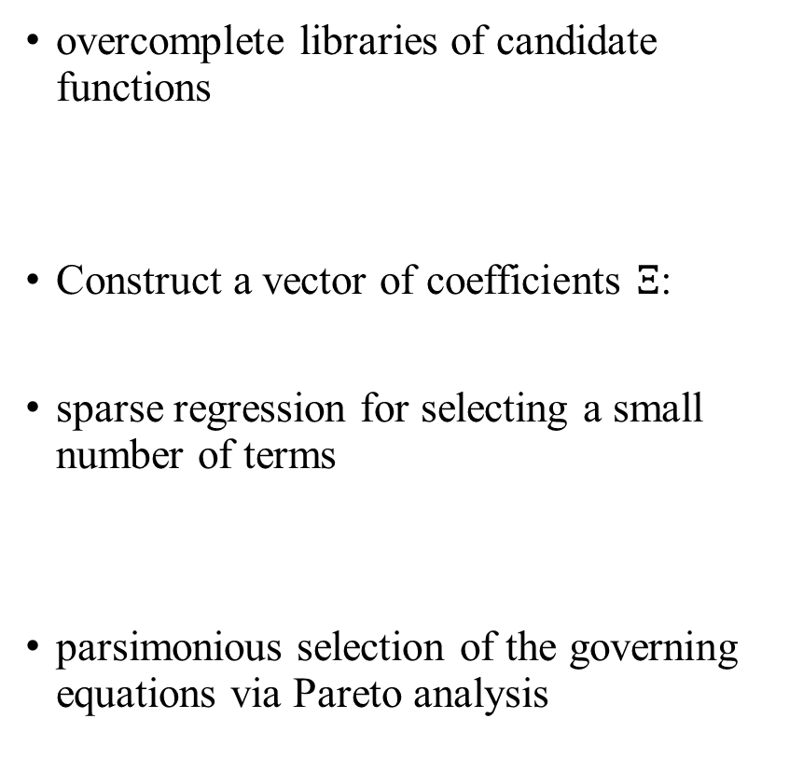
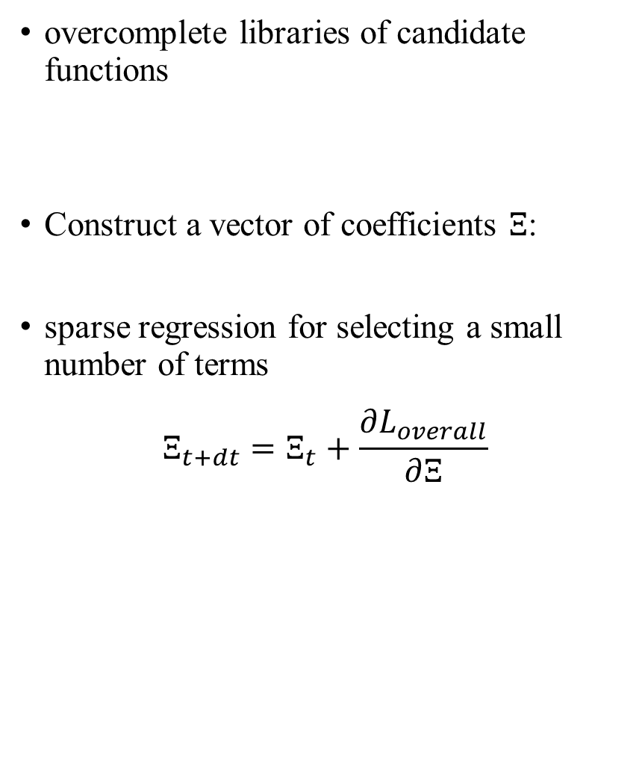
Main Method
overcomplete libraries of candidate functions
Construct a vector of coefficients $Ξ$:
sparse regression for selecting a small number of terms
parsimonious selection of the governing equations via Pareto analysis
overcomplete libraries of candidate functions
Construct a vector of coefficients $Ξ$:
sparse regression for selecting a small number of terms
$$Ξ_{t+dt}=Ξ_{t}+\frac{∂L_{overall}}{∂Ξ}$$

Slide 15
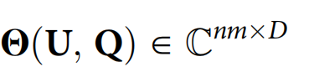
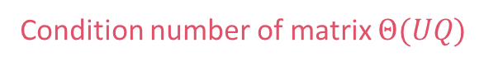
Main Method
Step 1: Building libraries of candidate terms.
Step 2: Construct a vector of coefficients :
Step 3: Use sequential threshold ridge regression for selecting a small number of terms:
Step 4: Use STRidge to solve the ridge regression:
Condition number of matrix $Θ(UQ)$

Slide 16
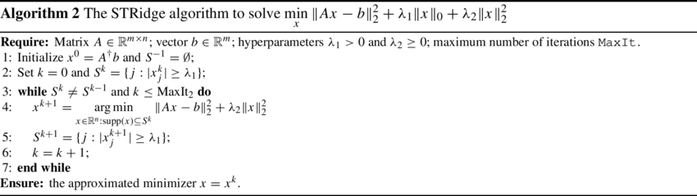
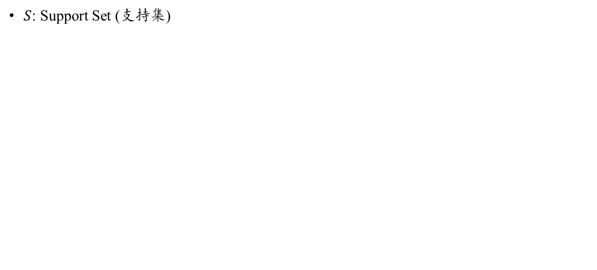
STRidge Algorithm
$S$: Support Set (支持集)
岭回归问题

Slide 17
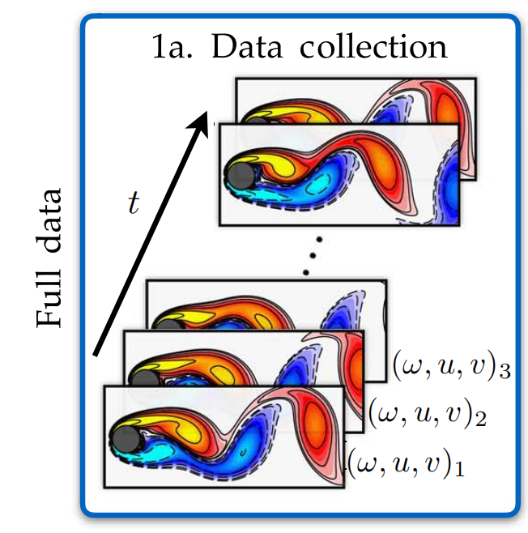
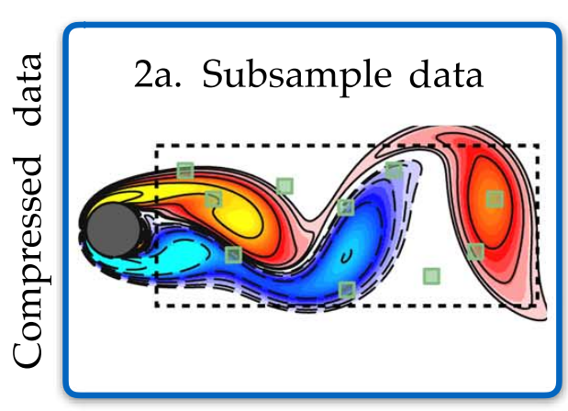
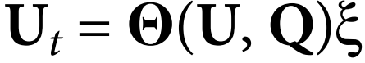
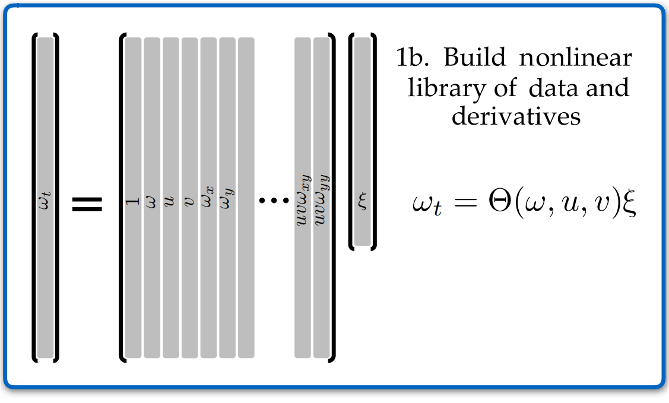
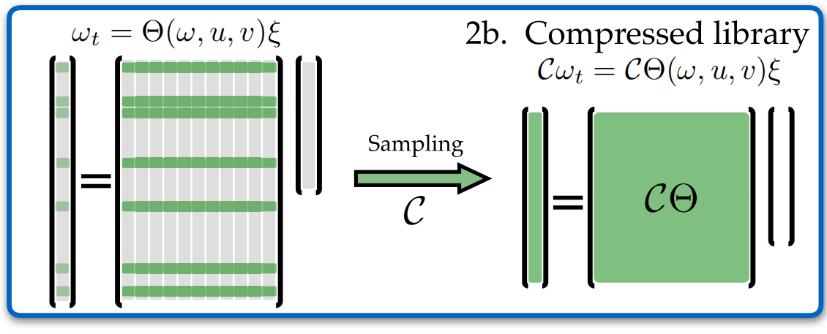
Detail 1 - Subsampling
How to sub-sample?
We randomly select a set of spatial points and uniformly subsample in time, resulting in the use of only a fraction of the data set.
Mathematical Understanding?
Ignore a fraction of the rows in the linear system

Slide 18
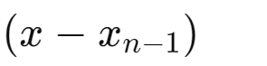
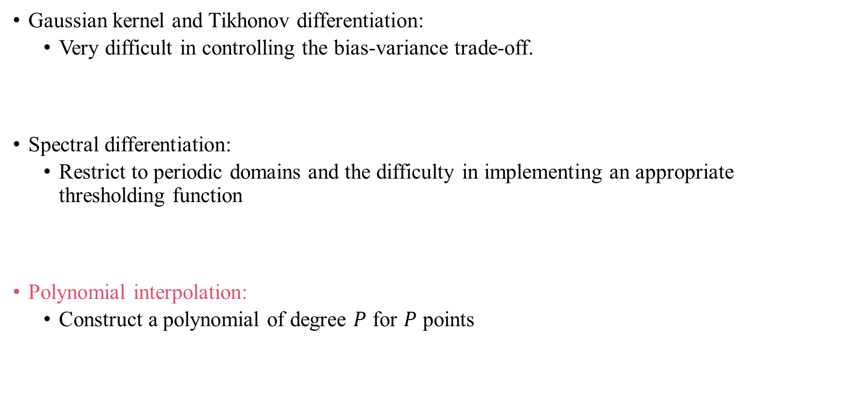
Detail 2 - Numerical evaluation of derivatives
Gaussian kernel and Tikhonov differentiation:
Very difficult in controlling the bias-variance trade-off.
Spectral differentiation:
Restrict to periodic domains and the difficulty in implementing an appropriate thresholding function
Polynomial interpolation:
Construct a polynomial of degree $P$ for $P$ points

Slide 19
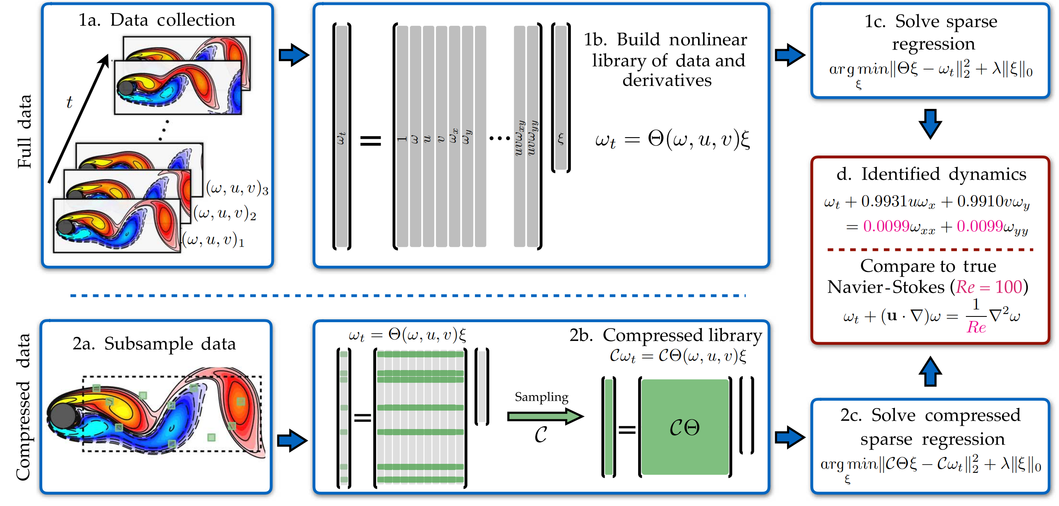
Main Results - Navier-Stokes equations

Slide 20
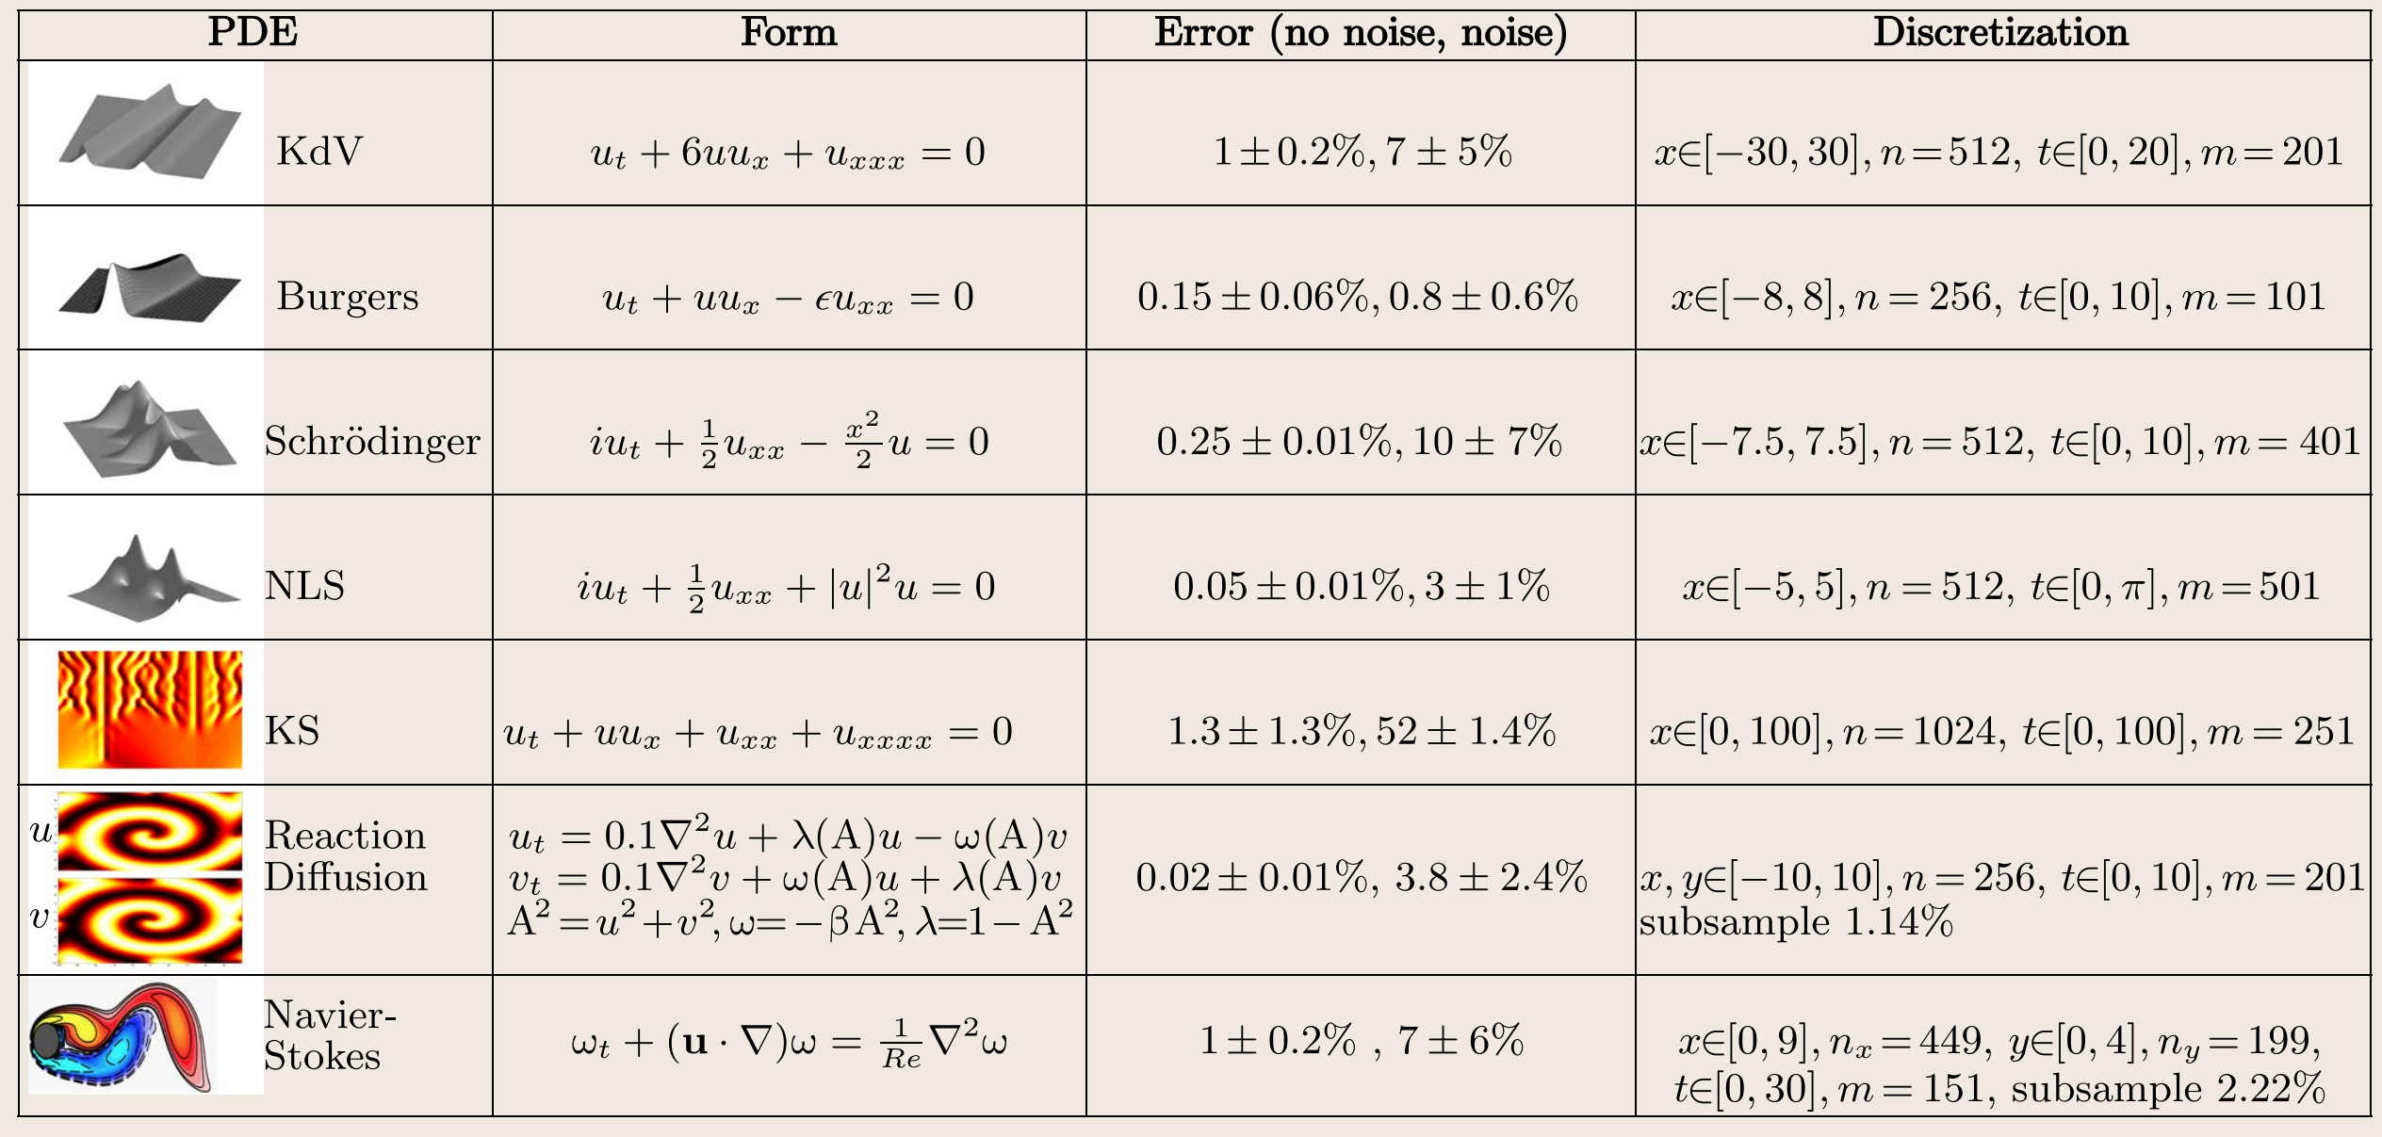
Main Results

Slide 21
DPOT: Auto-Regressive Denoising Operator Transformer for Large-Scale PDE Pre-Training
许笑颜
xxy1101@mail.ustc.edu.cn

Slide 22
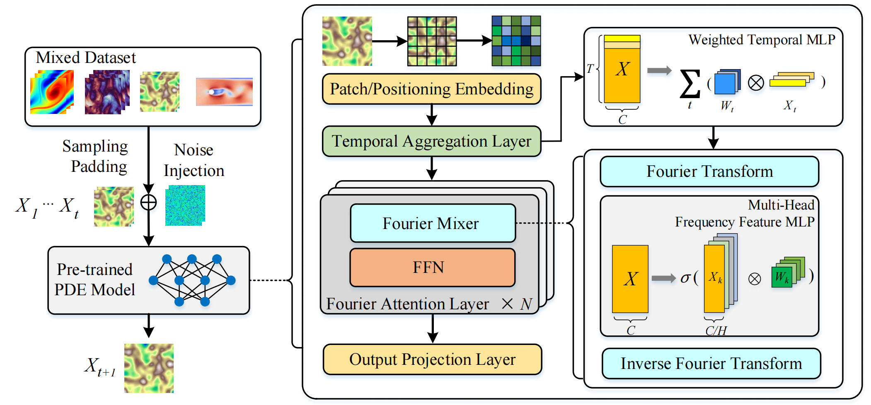
Model Pipeline

Slide 23
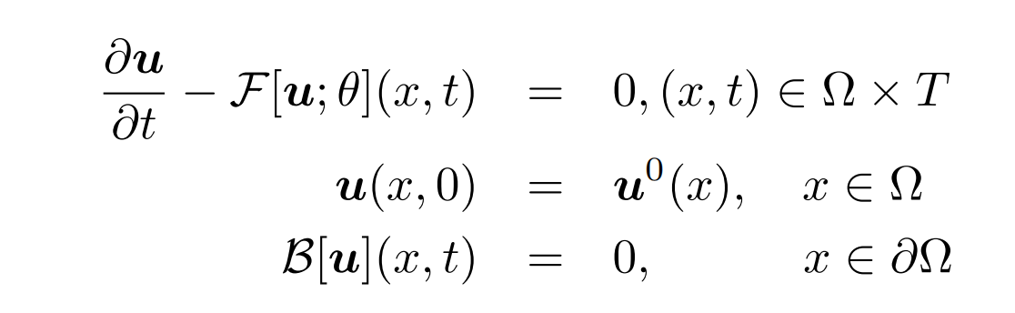
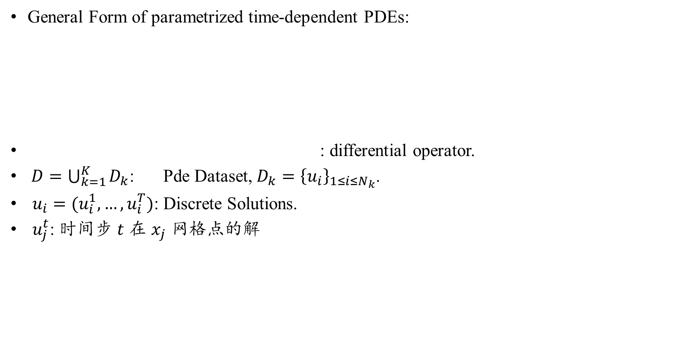
Problem Form
General Form of parametrized time-dependent PDEs:
: differential operator.
$D=\bigcup_{k=1}^{K}{D_{k}}$: Pde Dataset, $D_{k}={\left\{u_{i}\right\}}_{1≤i≤N_{k}}$.
$u_{i}=(u_{i}^{1},…,u_{i}^{T})$: Discrete Solutions.
$u_{j}^{t}$: 时间步 $t$ 在 $x_{j}$ 网格点的解
Boundary condition

Slide 24
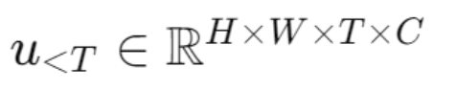
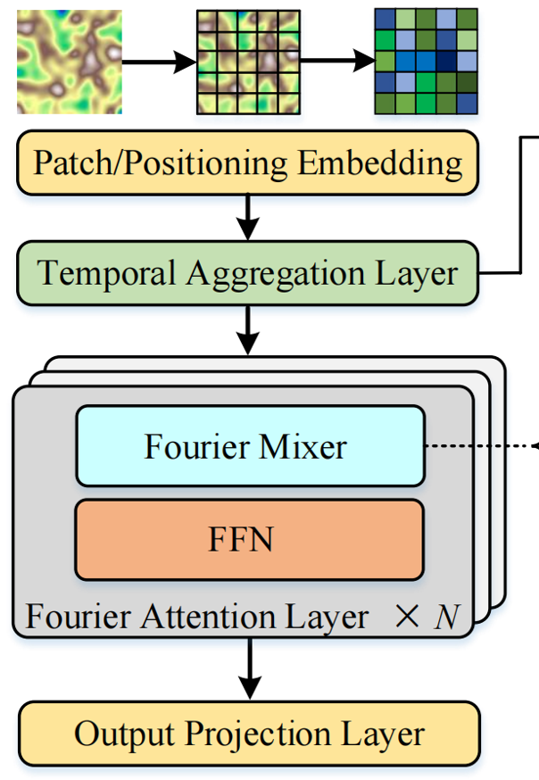
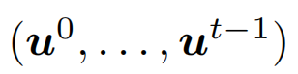
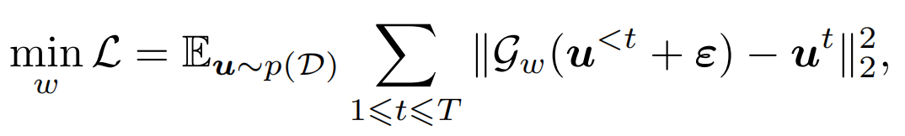
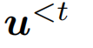
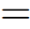
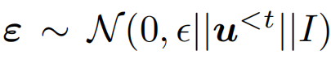
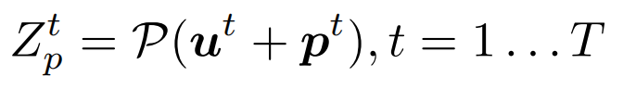
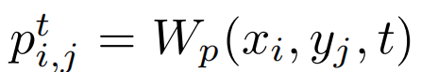
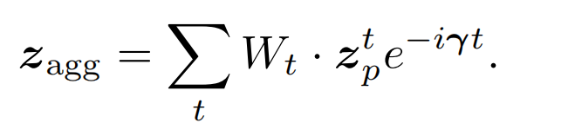
Model Architecture
Input Encoding and Temporal Aggregation
Input: Spatial Data
Add Noise & Denoise: injecting small-scale noise into the inputs
Patch Layer:
Time Aggregation:
Noise!
Optimization Object !
Positional encodings

Slide 25




Model Architecture
Fourier Attention Layer
kernel integral transform
frequency domain transformation
Update the hidden representation $z^{l}(x)$ in a Fourier attention layer
Multi-head Structure

Slide 26

Experiments & Results
Pre-trained & non-pre-trained small models

Slide 27

Experiments & Results
Fine-tuning results(downstream tasks)
training the DPOT from
scratch for 500 epochs
training for the same number of steps but using pre-trained weights for initialization

Slide 28

Experiments & Results
Scaling law
Before Fine tuning
After Fine tuning

Slide 29


PDE - Read

Slide 30

PDE - Read

Slide 31

PDE - Read

Slide 33

Research Background
How to discover governing equations from scientific data without prior knowledge ?
Conduct coordinate transformation into a reduced space
Identification of both the structure and parameters of nonlinear dynamical systems
Idea:
Design a custom deep autoencoder network
Discover a coordinate transformation into a reduced space.
Thus the dynamics may be sparsely represented.
About the autoencoder network:
SIND
Encoder & Decoder

Slide 34


A simple idea
How to conduct coordinate transformation?
Use an autoencoder.
$$x\left(t\right)∈ℝ^{n}⟶z\left(t\right)∈ℝ^{d}, d<n$$
$z=g_{Encoder}\left(x\left(t\right)\right), \hat{x}\left(t\right)=g_{Decoder}\left(z\left(t\right)\right)=g_{Decoder}\left(g_{Encoder}\left(x\left(t\right)\right)\right)$
Encoder —— Latent space —— Decoder
No guarantee that the intrinsic coordinates learned will have associated sparse dynamical models！

Slide 35


The necessity of physics
Without Physics Prior
With Physics Prior

Slide 36










Prior Knowledge
General dynamical system:
: the state of the system
: an submanifold of an $n$-dimensional vector space $ℝ^{n}$
$f$ : dynamics vector field
Koopman Theory:
find a new vector of coordinates $z$:
This work:
find a new vector of coordinates $z$:
Nonlinear $⇒$ Linear!
High-dimension $⇒$ Low-dimension!

Slide 37





Prior Knowledge - Sparse identification of non-linear dynamics
Consider a dynamical system of the form
1st Step: Construct a library of nonlinear candidate functions $Θ(X)$
2nd Step: Construct a vector of coefficients $Ξ$:
3rd Step: Assume admits a sparse representation in

Slide 38



Prior Knowledge - Sparse identification of non-linear dynamics
4th Step: Solve an optimization problem in finding a sparse $Ξ$ which optimally embeds :
$λ$ is a regularization parameter.
5th Step: Reconstruct the dynamical system.
How to solve?
Use least squares regression!

Slide 39





Main Method
Goal of the research: Identify the dynamic system from $x(t)$.
Assume reduced coordinates
Specify candidate basis functions $Θ(z)$:

Slide 40





Main Method
Protect the dynamic property of $x(t)$:
Protect the dynamic property of z$(t)$:

Slide 41



Main Method
Compute standard autoencoder loss(Reconstruction Loss).
Compute SINDy Regularization.
$$ℒ_{reg}={\left|\left|Ξ\right|\right|}_{1}$$
Combine the above 4 terms and gain the overall loss.
$$Ξ_{t+dt}=Ξ_{t}+\frac{∂L_{overall}}{∂Ξ}$$
Overall Loss!

Slide 42




Experiments & Results - Chaotic Lorenz System
Goal: 从已经给定的Lorenz System数据进行训练，观察其能否还原动力系统。
Training Dataset:
a nonlinear combination of the
true Lorenz variables !
Recover the correct sparsity of nonlinear dynamics systems!

Slide 43




Experiments & Results - Chaotic Lorenz System
怎么把Discovered Model转换为和True Model一样的变量形式?
define an affine transformation
Substitute into original equation:

Slide 44



Experiments & Results - Nonlinear Pendulum
Dataset: generate a series of snapshot images with a 2D Gaussian centered at the center of mass, determined by the pendulum’s angle z.
模拟非线性摆的运动，生成摆角 $z$ 随时间变化的轨迹。
使用这些轨迹生成一系列包含2D高斯分布的图像，这些图像表示了摆在不同时间点的位置。
L2 error of Model 1:
$x$: $8×{10}^{−4}$
$\ddot{x}$: $3×{10}^{−4}$
$\ddot{z}$: $2×{10}^{−2}$

